Slide 1

Introduction to SINGLE CELL RNA-SEQ
Analysis of single cell RNA-seq data
Katarzyna Kania (CRUK CI Genomics Core Facility)
12th September 2022

Slide 2
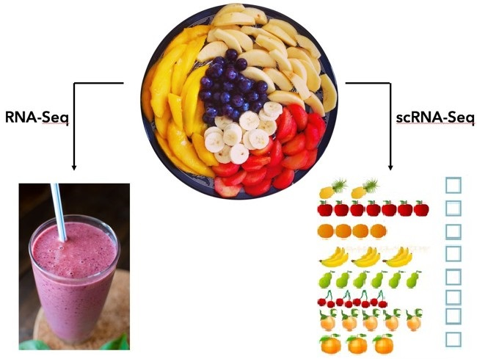
Bulk vs single cell rna-seq
Average expression level
Comparative transcriptomics
Disease biomarker
Homogenous systems
Separate populations
- Define heterogeneity
- Identify rare cell populations
- Cell population dynamics
Notes:
flavours

Slide 3
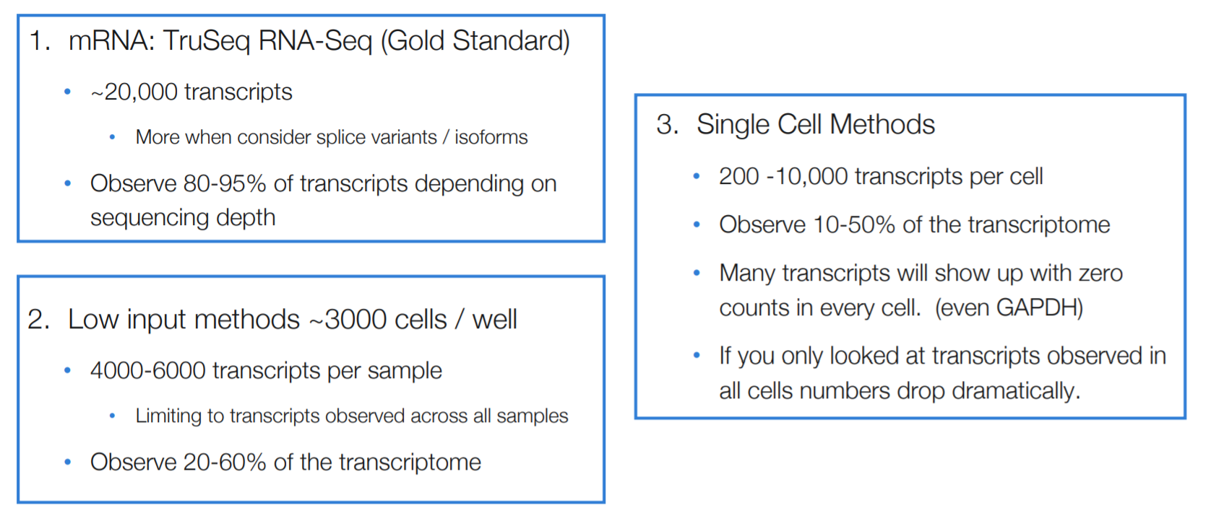
Bulk vs single cell rna-seq
Source: Sarah Boswell, Harvard Medical School, September 2020
Notes:
Unravel tissue heterogeneity: Novel and rare cell types Unknown cellular states Transcriptional dynamics Can also measure single-cell: Chromatin accessibility Mutation & CNV (scDNAseq) Methylation Measures the average expression level for each gene across a large population of input cells
Useful for comparative transcriptomics, e.g. samples of the same tissue from different species
Useful for quantifying expression signatures from ensembles, e.g. in disease studies
Insufficient for studying heterogeneous systems, e.g. early development studies, complex tissues (brain)
Does not provide insights into the stochastic nature of gene expression
Measures the distribution of expression levels for each gene across a population of cells
Allows to study new biological questions in which cell-specific changes in transcriptome are important, e.g. cell type identification, heterogeneity of cell responses, stochasticity of gene expression, inference of gene regulatory networks across the cells.

Slide 4
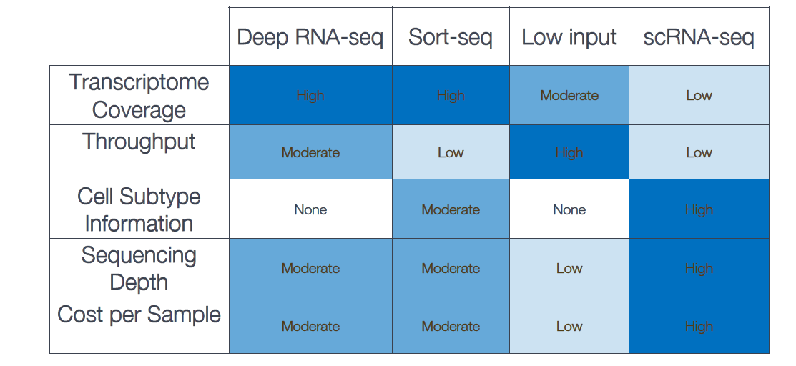
Bulk vs single cell rna-seq
Disadvantages of scRNA-seq
Dropouts and noisy data
Lowly expressed genes might be undetected
Samples will contain doublets
Replicates without batch effect are unlikely
Expensive
Source: Sarah Boswell, Harvard Medical School, September 2020
Notes:
Deep diving data acquisition
After bulk, experimental needs
High level phenotyping
typical sort-seq experiment ) begins with a mixed population or library of variants of a given gene or sequence of interest, whose function is indicated by a fluorescent reporter. Cells are sorted and binned according to flow cytometry measurements such as fluorescence in one or more channels. Sorted subpopulations are then sequenced in order to parse the distribution of different variants across the sorting bins. These data may then be used to infer the activity of each variant, allowing the direct characterization of sequence-function relations on a large scale.

Slide 5
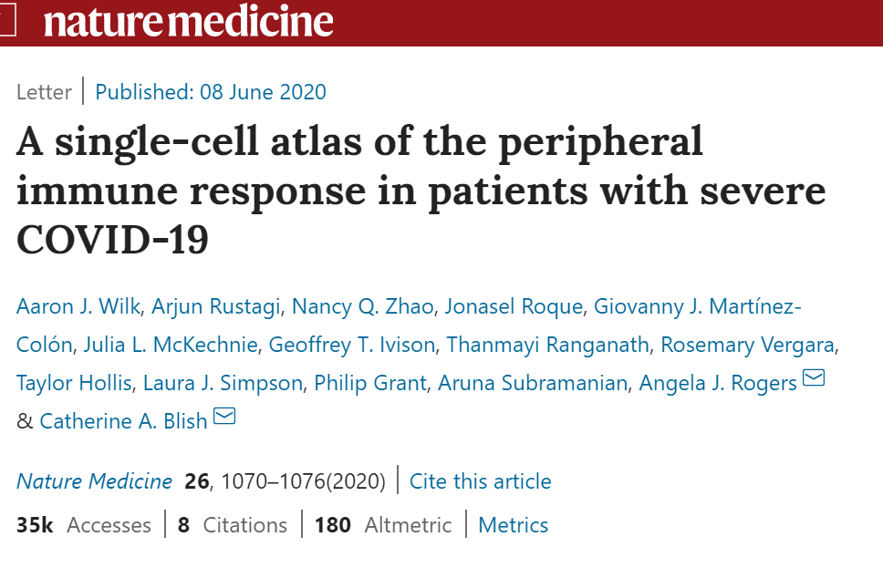
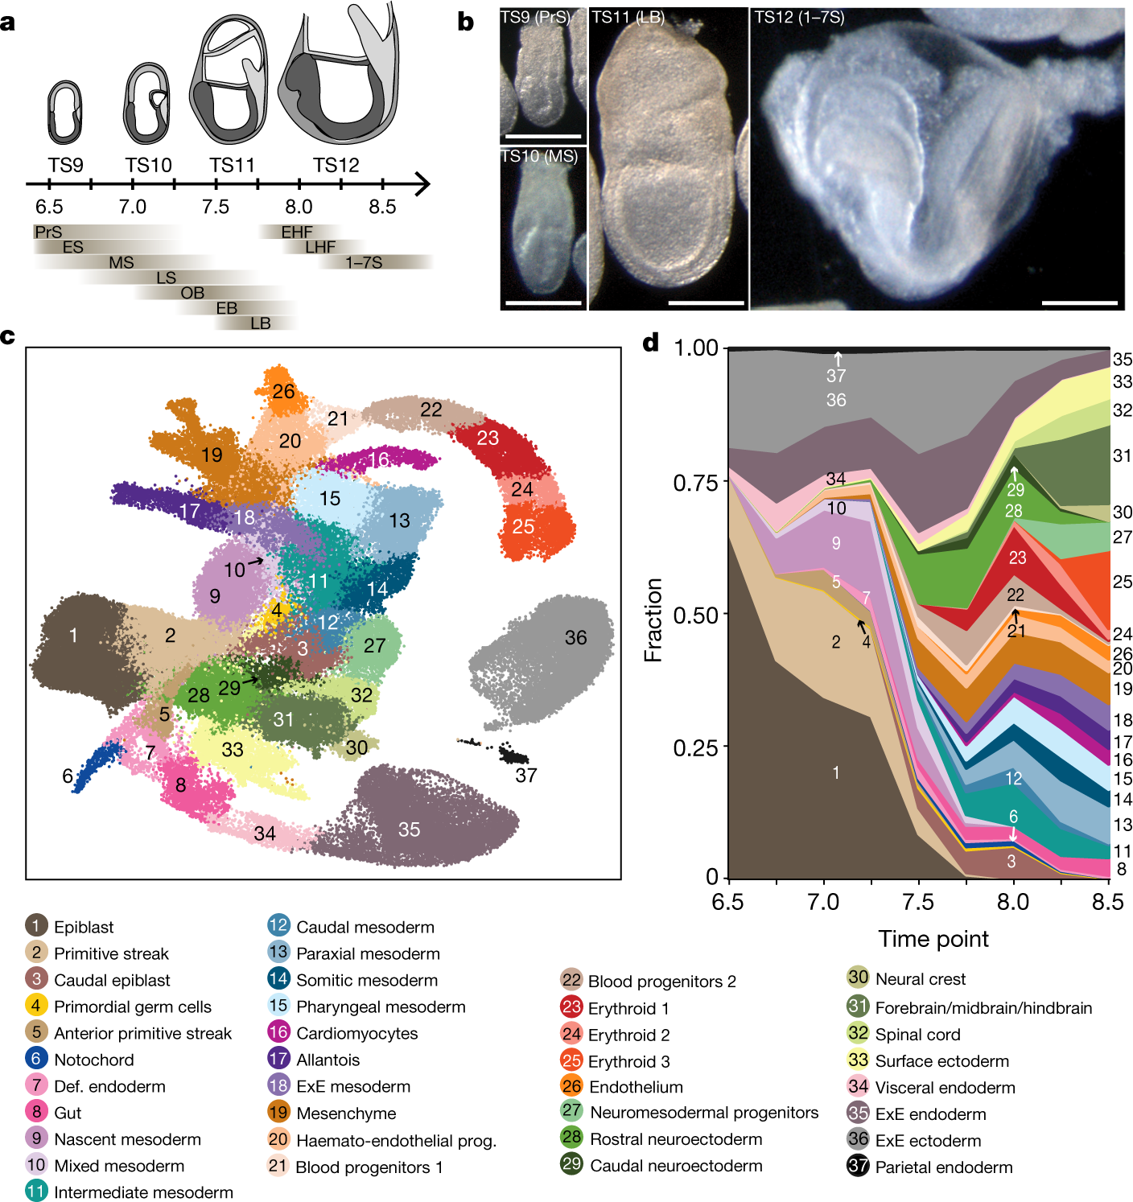
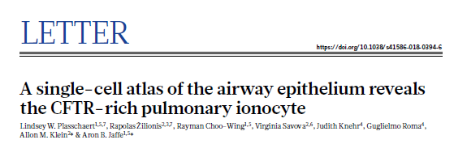
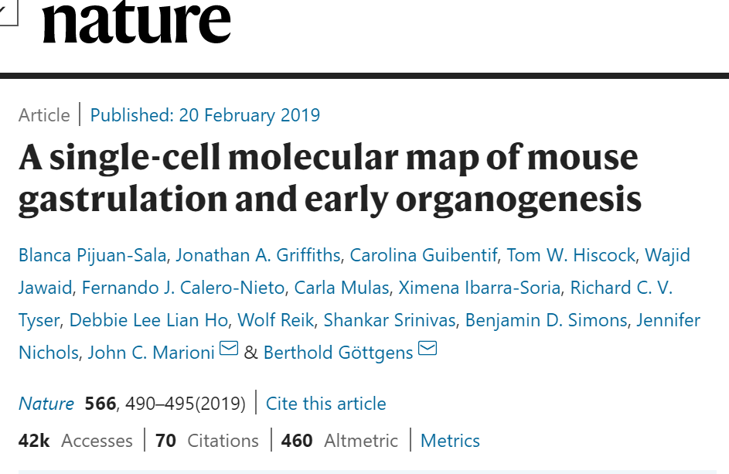
applications
Source: Pijuan-Sala et al. Nature 566, 490–495 (2019)
Notes:
Studying heterogeneity, cellular responses or development lineage tracing
‘Real time movie’

Slide 6
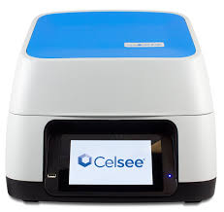
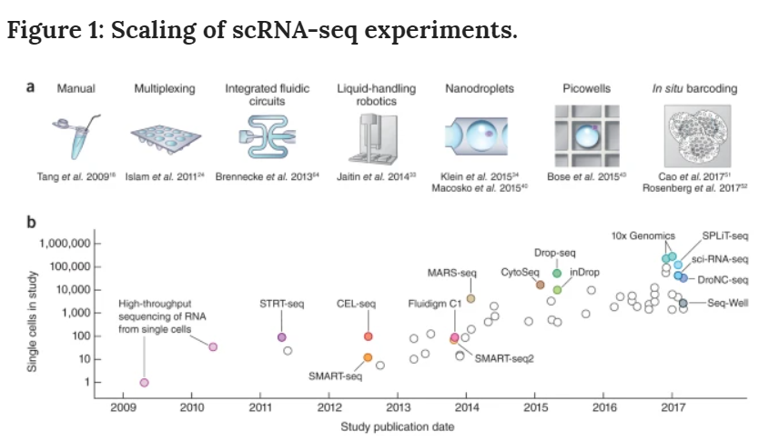
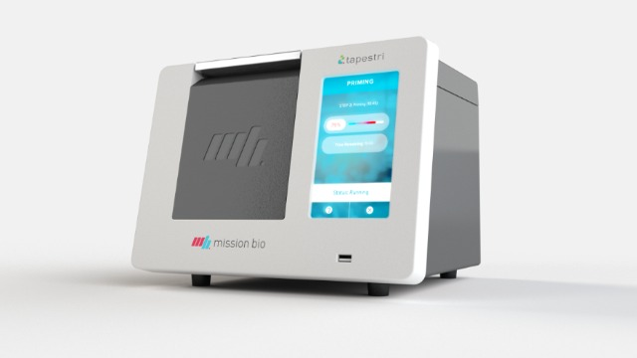
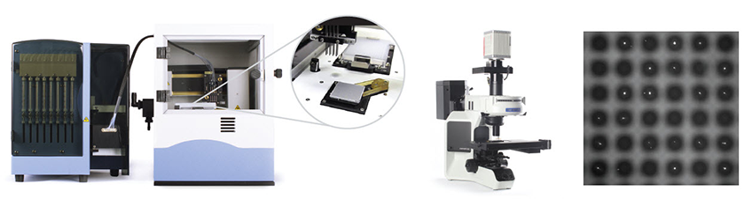
Technologies
Source: Svensson et al. Nat Protoc 13, 599–604 (2018)
Notes:
development of new methods and protocols for scRNA-seq is currently a very active area of research, and several protocols have been published over the last few years. A non-comprehensive list includes:
Mission Bio, In-Drops, Celsee, SmartSeq v4, ICELL8 (change picture) Fludigm came and disappeared
10x dna sequencing (not single cell) genome assembly, manipulating droplets
2016 Human cell atlas global effort of 44 coutries – comprehensive reference map of types and properties of all human cells, the fundamental unit of life as basis of understanding, diagnosing, monitorning and treating health and disease

Slide 7
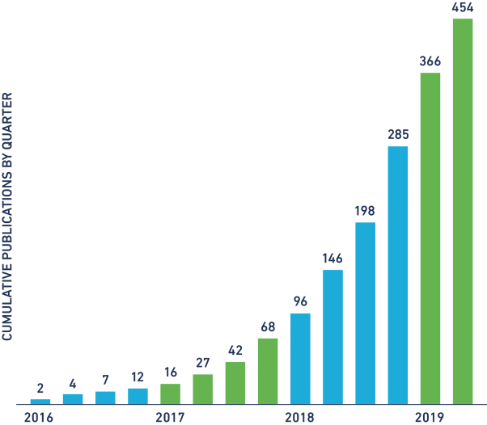
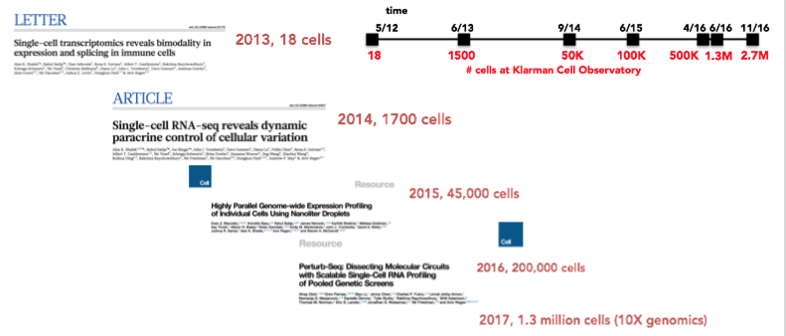
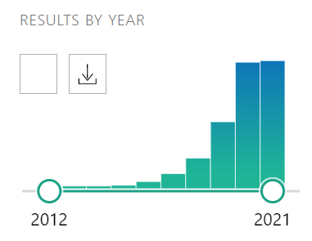
History and progress
Publications using 10x Genomics
PubMed search for ‘scRNA-seq’
Source: Introduction to scRNASeq, Timothy Tickle & Brian Haas, Broad Institute, 2017
Notes:
expontnetial

Slide 8
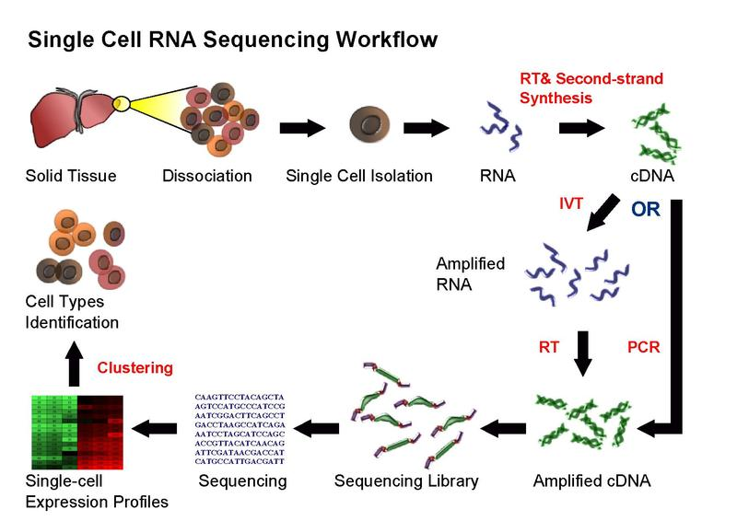

workflow
Good sample preparation is key to success!
Source: https://en.wikipedia.org/wiki/Single_cell_sequencing
Notes:
Dissociation can be easy (blood) or hard (collagenous tissue) Separation and RT differ by protocol
Cell isolation – FACS, nanowell, droplet, split barcoding
Library prep – polyA vs random priming, 3/5 bias vs full length, PCR vs in vitro trancscription
Sequencing – illumina, NanoPore
cDNA strand is used as a template for in vitro transcription (IVT). 1 The RNA polymerase produces multiple copies of antisense RNA (aRNA) with amplification factors of up to 1000-fold. Because of random priming to synthesize the second strand, the IVT products are not full-length copies, and the 5′-terminal sequences of the transcripts are underrepresented in the aRNA. T

Slide 9
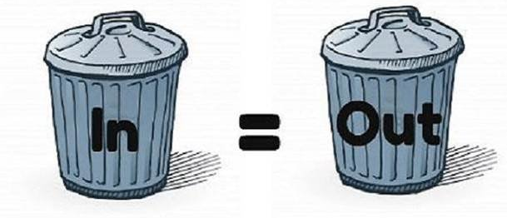
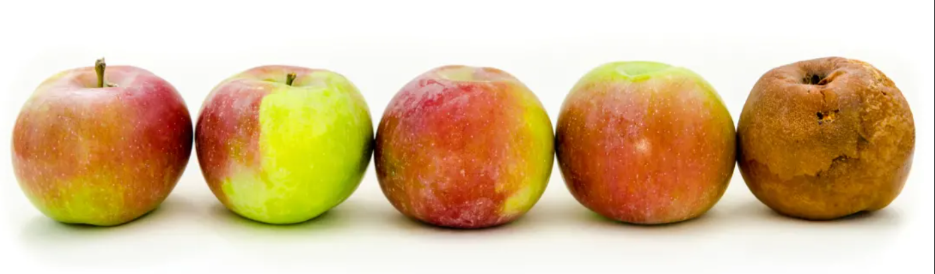
SAMPLE preparation
Understand well the nature of the sample (sampling conditions, preparation, purity)
Identify the source of technical difficulties in order to resolve them first
Practice your sample preparation, optimise the protocol well, do not rush to the final experiment
A well planned pilot experiment is essential for evaluating sample preparation and for understanding the required number of cells.
You need your cells to be highly viable (>90-95%), have no clumps and no debris. Cell membrane integrity is a must!
Free-floating RNA will make analysis more challenging
Be cautious about FACS (especially with more fragile cells). If FACS necessary for enrichment, remember that time is crucial factor
Count with haemocytometer or cell counter (Countess II Automated Cell Counter) – do not trust sorter counts
Fixation and cryopreservation are not compatible with many techniques
Notes:
Gentle treatment, short sample preparation, low temperature. Protocols will vary for different cell type
Usual buffer: PBS with 0.1-1% BSA (no EDTA, Mg+, Ca+, Tween)

Slide 10
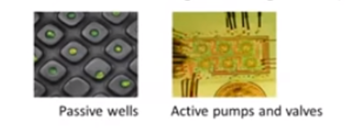
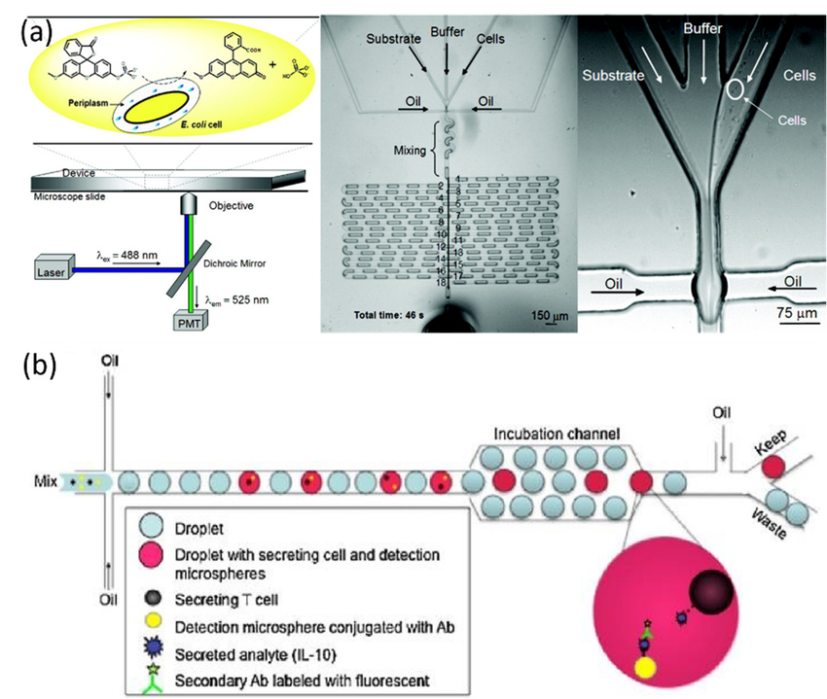
Methods
Cells in wells, traps and valves (nanowell, Flow sorting, CellenOne,
Fluidigm C1, SmartSeq, plexWell/seqWell)
- Screen for and retrieve single cells of interest
- Enrich for rare cells with decided properties
- Control the cellular microenvironment
- Monitor and control cell-cell interactions
- Precise/extensive manipulation of single cells
2) Droplets (Drop-seq, 10x Genomics)
Introduce distinct ‘packets’ of reagents to single cell (e.g. barcodes)
Perform amplification on individual cells
Sort large population of single cells
3) Combinatorial indexing (SCI-seq, SPLiT-seq)
Economic use of reagents for cell separation
Efficiency of handling larger population than Drop-seq
Maintain complexities of population without bias from droplet or well
4) ‘One tube’ solutions (SciPio Bioscience, Fluent Bioscience, CS Genetics)
Source: Wen et al. Molecules (2016)
Notes:
every method has it’s pros and cons. There is no all-encompassing single cell methodology.Poisson distribution

Slide 11
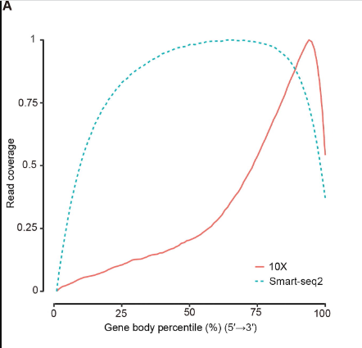
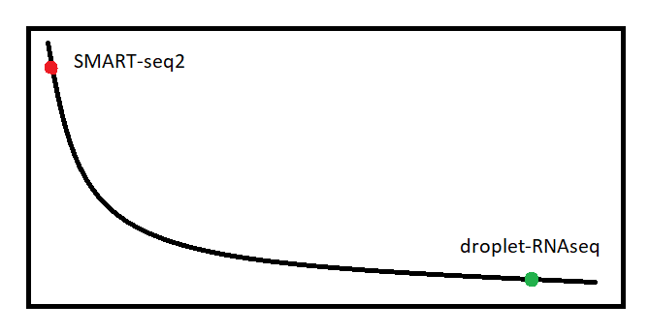
More CELLs or MORE GENES?
genes
cells
SMART-seq2
100 cells
Full-length libraries
1M reads per cell
Droplet-RNAseq
10000 cells
50k reads per cell
3’/5’ bias
Source: Wang, et al. Genom. Proteom. Bioinform. 19(2), 253-266 (2021).
Required number of cells increases with complexity of the sample.
Number of reads will depend on biology of sample
Cell-type classification of a mixed population usually requires lower read depth
You can always re-sequence your samples.

Slide 12
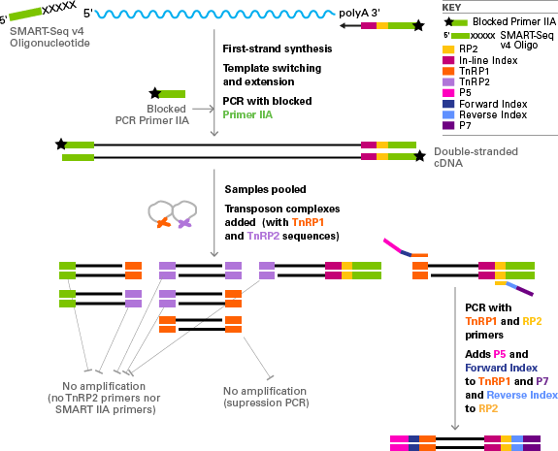
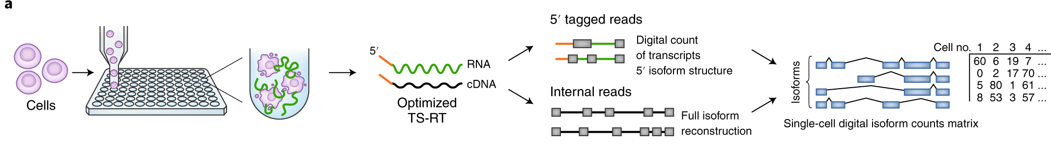
SMART-SEQ2/3/4 overview
Developed for single cell but can performed using total RNA.
•Selects for poly-A tail.
•Full transcript assay.
Uses template switching for 5' end capture.
•Standard Illumina sequencing.
•Plate-based solution so labour intensive, slow and costly (~$12/cell)
Source: TakaraBio
Source: Macosko, Nat Biotechnol 38 (2020).
Notes:
Improvement in buffers, polymerases, performance Takara Smartseq / Illumina NExtera

Slide 13
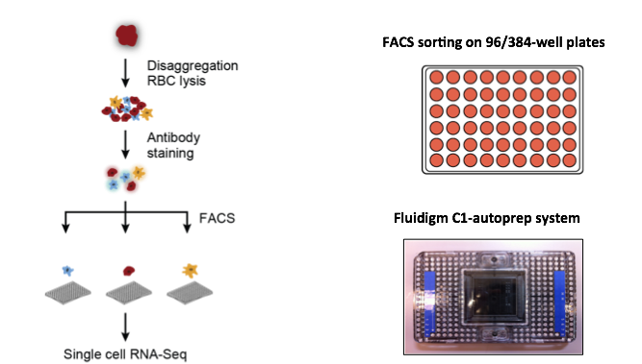
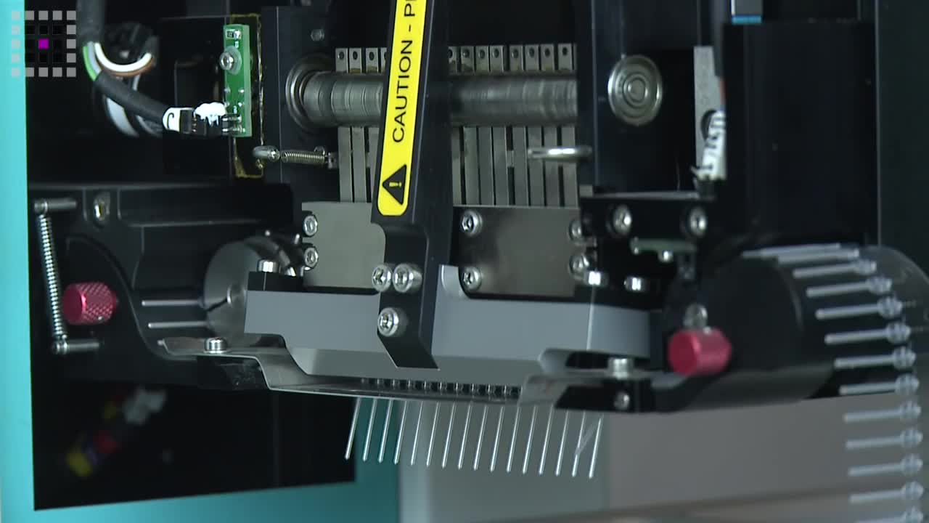
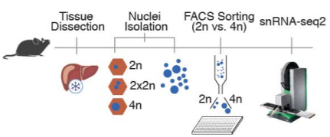
SMART-SEQ2/3/4 + Mosquito LV
Source: SPT Labtech
Mosquito LV makes assay miniaturisation simple, leading to significant savings on precious reagents and time.
Mosquito LV offers highly accurate and precise multichannel pipetting from 25 nL to 1.2 µL.
SmartSeq2 cost reduced from $12 to $4 per cell
Richter et al. Nat Commun 12, 4264 (2021)
Notes:
Celia’s paper single nucleus rna-seq2 crosstalk
Couldn’t afford 1/8 takara 1/12 nextera cost saving half million (80000 robot)

Slide 14
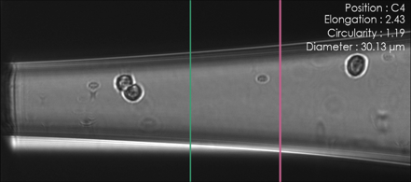
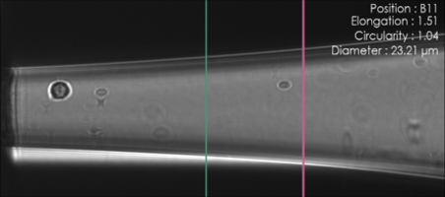
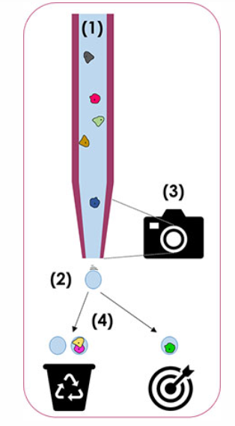
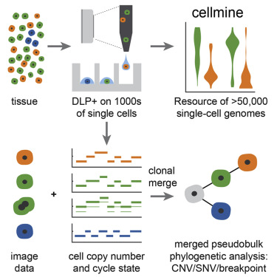
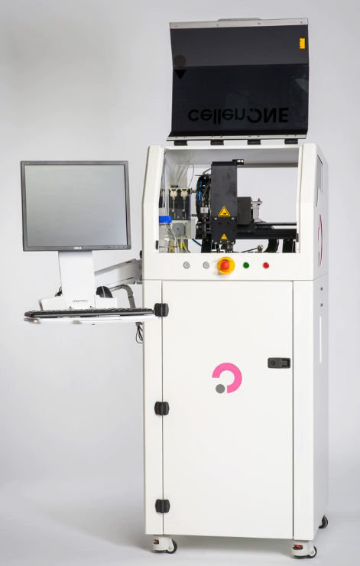
CELLEnOne
Cell suspension is aspirated into a glass capillary
Generation of drops on demand, in air
Thanks to automated imagining, cellenONE tracks cells and determines if upcoming drops will contain or not a single cell
Drops containing single cells are dispensed into selected targets, drops without cells or with more than one cells are dispensed into recycling tube
Source: Cellenion
Source: Laks et al. Cell. 179(5):1207-1221.e22. (2019)
Source: Cellenion
Notes:
Parameters
Flowcytometry+mosquito control

Slide 15
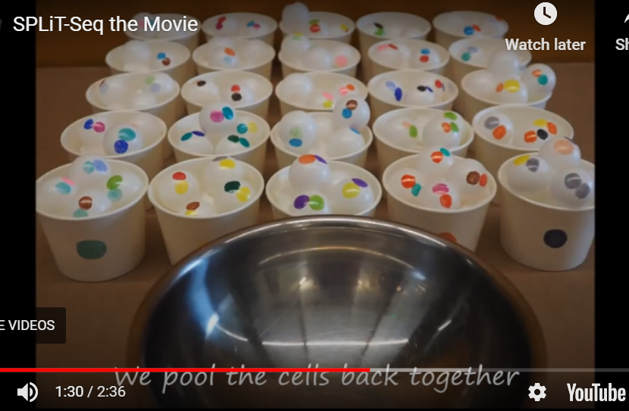
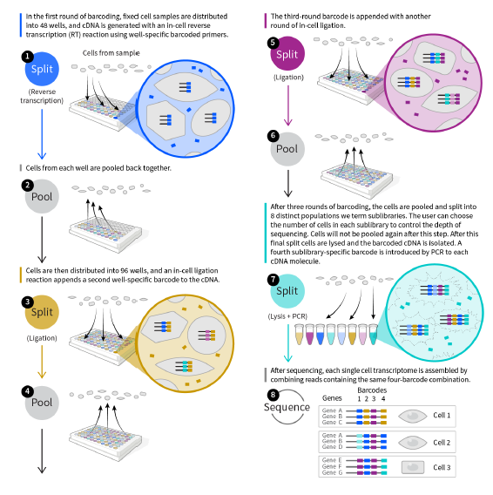
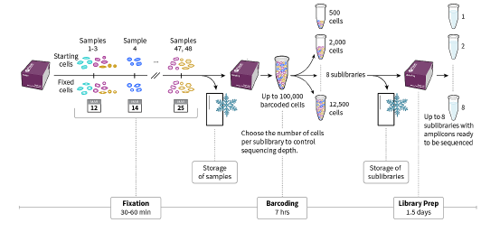
SPLIT-SEQ overview (Parse Biosciences, Scale Bio)
Video available at: https://sites.google.com/uw.edu/splitseq
Time flexibility – single experiment for samples collected on different dates (up to 6months storage)
No instrument required for experiment. Computational pipeline available
Up to 48 samples / 100k cells in total – kit has to be used at once
Retail price of $9,800 per 100k cells or $16700 per million cells (+fixation kits)
Doublet rate of 0.27% per 1000 cells (3.4% per library)
No 3’/5’ bias – random hexamers method
Median genes detection of about 12,000 genes
Works with any species, any sizes of cells/nuclei & results in lower background noise

Slide 16
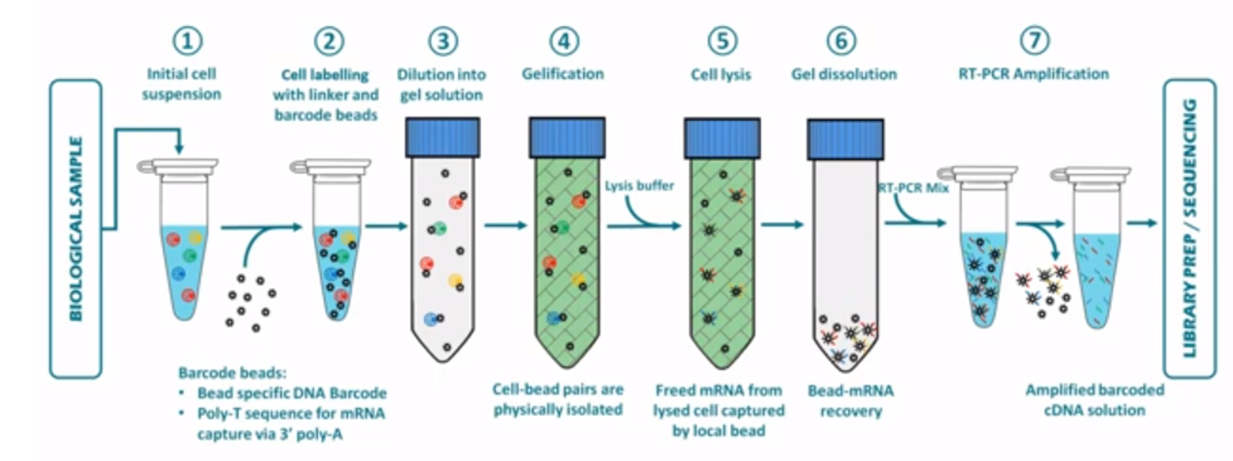
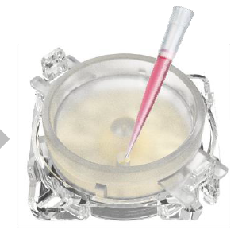
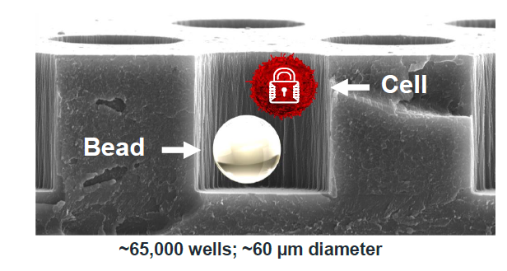
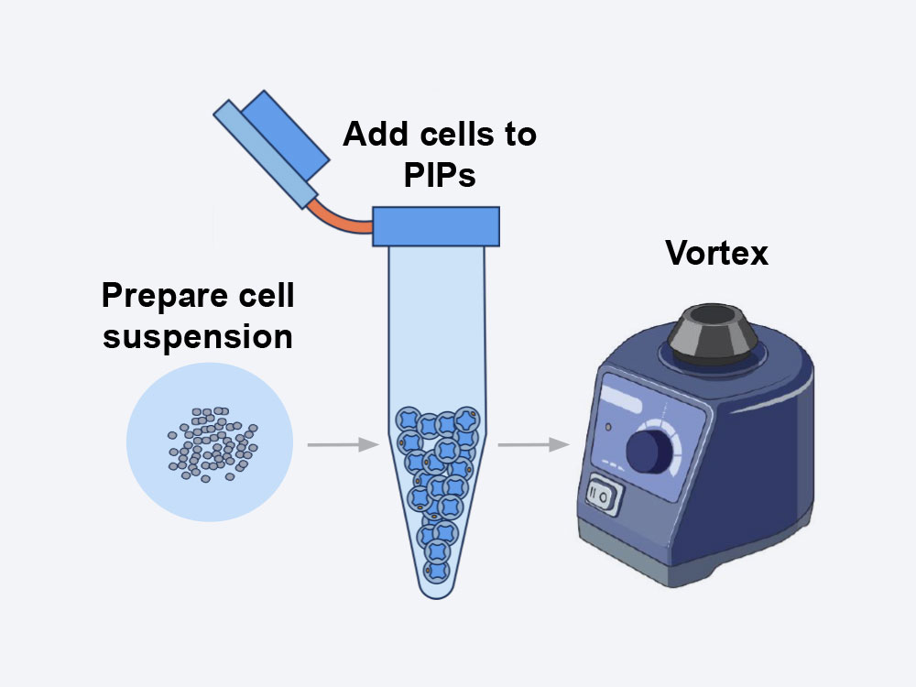
New products (HIVE, SCIPIO, FLUENT)
Honeycomb HIVE
Capture Cells - Load cells into the HIVE and allow single cells to settle gently into HIVE picowells containing barcoded mRNA-capture beads
The HIVE Difference: Store Or Ship - With cells in a stable environment, store HIVEs in the freezer and/or ship when ready to process
Asteria (SciPio Bioscience) - hydrogel technology, a new era of instrument-free, ready-to-use scRNA-seq experiments
Fluent BioSciences
- during sample preparation, cell suspension of interest is mixed with our core template particles and segregated into Pre-templated Instant Partitions (PIPs) by simple vortexing
- Great scalability depending on experiment needs (2K cells= $300, 20k cells=$900)

Slide 17
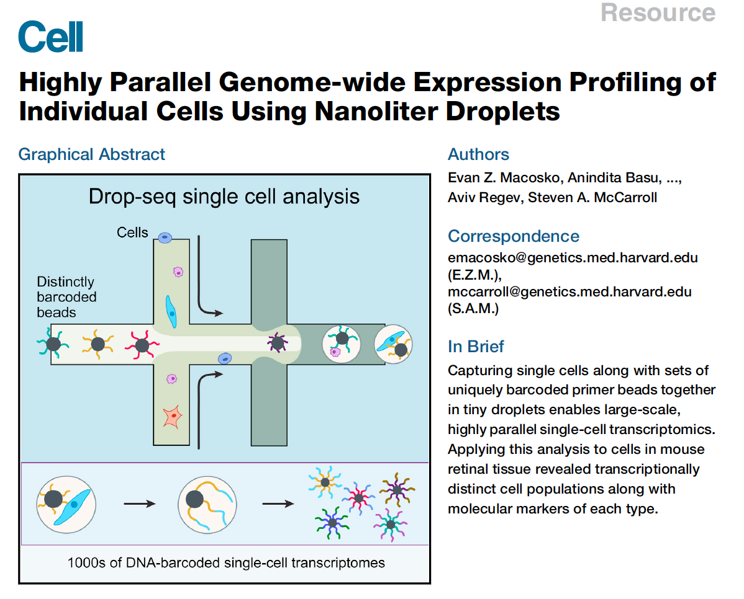
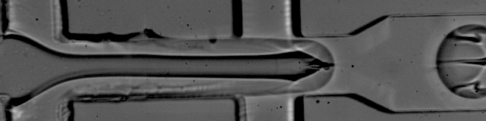
DROP-SEQ overview
Moved throughput from hundreds to thousands.
Droplet-based processing using microfluidics
Nanoliter scale aqueous drops in oil.
3' End
Bead based (STAMPs).
Single-cell transcriptomes attached to microparticles.
Cell barcodes use split-pool synthesis.
Uses UMI (Unique Molecular Identifier)
Chance to have two cells within one droplet
Notes:
Doublet frequency is positively correlated with throughput
Mixed species

Slide 18
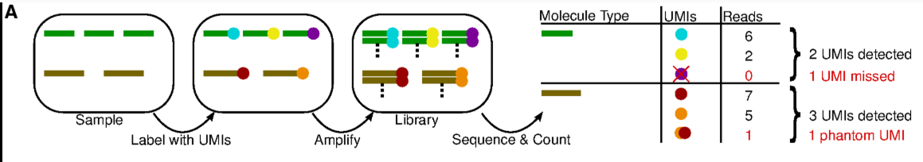
UMI – unique molecular identifiers
After PCR enrichment, without UMIs, one can not distinguish if multiple copies of a fragment are caused by PCR clones or if they are real biological duplicated.
By using UMIs, PCR clones can be found by searching for non-unique fragment-UMI combinations, which can only be explained by PCR clones.
When performing variant analyses, these falsely overrepresented fragments can result in incorrect calls and thus wrong diagnostic findings
Source: Pflug et al. Bioinformatics (2018)
Notes:
They reduce the amplification noise by allowing (almost) complete de-duplication of sequenced fragments. (low imput, transcript dropout but doesn’t correct low capture rated whicleads to abundance or false negatives)
The relevant steps of library preparation when the UMI method is used. The sample initially contains three copies of molecule graphic and two copies of graphic, which are made unique by labelling with UMIs (graphic). Each of those molecules is expanded into a molecular family during amplification, and a random selection of molecules from these families is sequenced. Counting unique UMIs then counts unique molecules, unless UMIs have read-count zero (graphic) or phantom UMIs are produced (graphic).

Slide 19
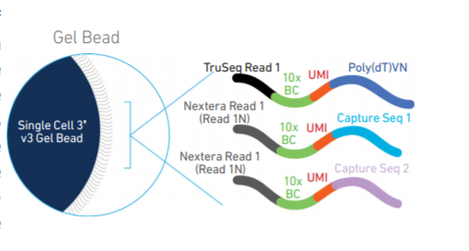
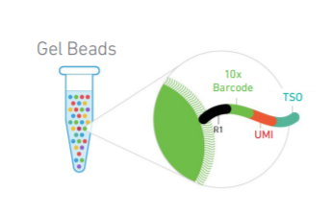
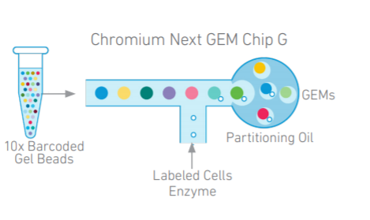
10x Genomics overview
- Droplet-based similar to Drop-Seq, 3’ or 5’ mRNA
In contrast to Drop-seq, where solid beads are used for RNA capture, 10X uses soft hydrogels containing oligos. These enable “single Poisson loading” leading to capture of >60% of input cells.
Standardized instrumentation and reagents (unhackable so no customisation or control)
Very easy to use and less processing time
More high-throughput scaling - 8 samples can be processed simultaneously with up to 10000 cells captured per sample
The doublet rate increases with number of cells loaded
CellRanger and CellLoupe software are available and user friendly
Source: 10x Genomics

Slide 20
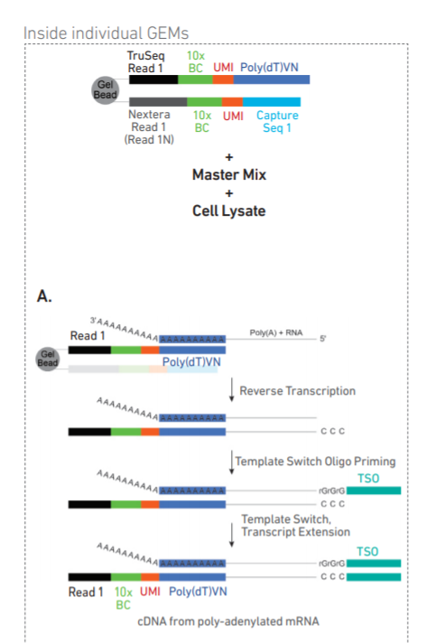
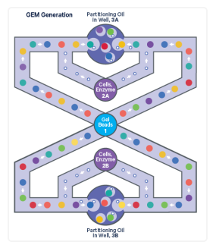
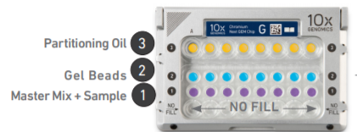
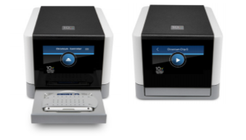
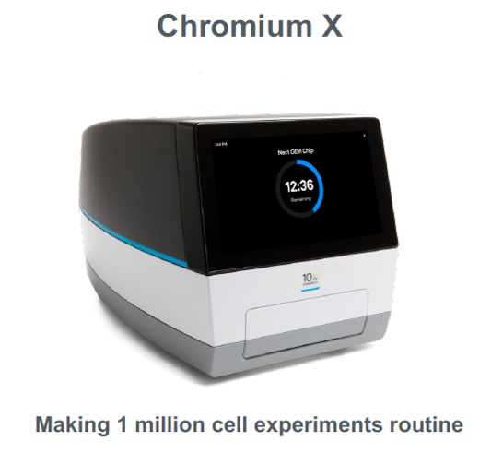
10x Genomics overview
Source: 10x Genomics

Slide 21
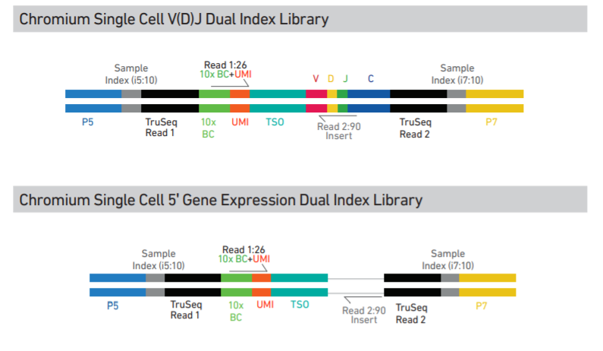


10x Genomics libraries
Source: 10x Genomics
Sequencing Read | Description | Number of cycles
Read1 | 10x Barcode Read (Cell) + Randomer Read (UMI) | 28bp
i7 index | Sample index read | 10bp
i5 index | Sample index read | 10bp
Read2 | Insert Read (Transcript) | 90bp

Slide 22



Multiomics Age
Source: 10x Genomics
Kashima Y et al. Exp Mol Med 52, 1419–1427 (2020)

Slide 23


CITE-SEQ
- Cellular Indexing of Transcriptomes and Epitopes by Sequencing
- CITE-seq uses DNA-barcoded antibodies to convert detection of proteins into a quantitative, sequenceable readout
BioLegend solutions:
TotalSeq-A – Poly(dT) based system
TotalSeq-B – 3’ v3.1 Feature barcode
TotalSeq-C – 5’ v2.0
Source: cite-seq.com
Source: Stoeckius et al. Nat Methods. (2017)

Slide 24




CELL hashing
Reduces cost of running multiple samples by adding hashtag oligos and pooling into single channel of 10x chip (10x CellPlex or TotalSeq antibodies)
Allows overloading as by sequencing tags alongside the cellular transcriptome, we can assign each cell to its sample of origin, and robustly identify doublets originating from multiple samples
Source: cite-seq.com

Slide 25





Tissue Preservation/CELLs FIxation
10x Fixed RNA Profiling
new chemistry, compatible with formaldehyde fixed samples
RNA is captured using probes, not poly(d)T like in 3’ solution
Available for human (~18k genes) and mouse (~20k genes) only
Probes contain barcodes so no additional staining needed for cell hashing
Kit potentially opens the door to archival material (FFPE blocks)
pre-print: snPATHO-seq: unlocking the FFPE archives for single nucleus RNA profiling
SplitSeq (Parse Bioscience) requires fixation as well

Slide 26


10x ATAC
Sequencing Read | Description | Number of cycles
Read1 | Insert Sequence 1N | 50bp
i7 index | Sample index read | 8bp
i5 index | 10x Barcode Read (Cell) | 16bp
Read2 | Insert Sequence 2N (opposite end) | 50bp
- ASAP-seq is to scATAC-seq what CITE-seq is to scRNA-seq.
- Scale Biosciences – ‘pre-indexing of nuclei through tagmentation’ = 100k nuclei per 10x channel with low number of doublets
Source: 10x Genomics

Slide 27


10x Multiome (RNA+ATAC)
Source: 10x Genomics
-TEA-seq (Transcription, Epitopes, and Accessibility) = Multiome with permabilised cells & CITEseq

Slide 28




SPATIAL TRANSCRIPTOMICS
55ul spots -> 1 and 10 cells captured per spot
Source: 10x Genomics
2022
Source: Liao et al. Trends in Biotechnology. (2020)
Source: 10x Genomics
Notes:
scRNA-seq requires tissue dissociation and so is unable to retain information about the position of cells in the tissue context.
This spatial information captures the local microenvironment that determines how the cell functions, which cell types it may differentiate into, or what cell state it may be in. Techniques for measuring gene expression within the tissue context range from microdissection, in situ RNA hybridization, and immunohistochemistry to in situ sequencing of genes, a

Slide 29



SPATIAL TRANSCRIPTOMICS
Source: 10x Genomics
- Visium FFPE uses probe based chemistry similarly to Fixed RNA profiling for single cell

Slide 30


Experimental design
Source: Baran-Gale et al. Brief Func Genomics. 17 (4):233–239. (2018)
Source: Nguyen QH et al. Front Cell Dev Biol 6:108. (2018)
Notes:
good experimental design doesn’t remove batch effects, it prevents them from biasing your results (hopefully)

Slide 31
What platform Should I use?
Choose protocol based on:
- Throughput (number of cells per reaction)
- Sample of origin
- Cost / Labour / Time limitations
- Gene body coverage: 5’/ 3’ biased or full-length?
- UMI vs no-UMI
- Sequencing depth per cell
Examples:
If you sample is fairly homogeneous – bulk RNAseq
If your sample is limited in cell number – plate-based method
If you want re-annotate the transcriptome and discover new isoforms – full-length coverage (SMART-seq2, seqWell)
If you are looking to classify all cell types in a diverse tissue - high throughput
If you have only archival human samples – nuclei isolation or 10x fixed RNA profiling

Slide 32

Literature:
https://hbctraining.github.io/scRNA-seq/slides/Single_Cell_2_27_20.pdf.
https://www.slideshare.net/TimothyTickle/introduction-to-singlecell-rnaseq
Arzalluz-Luque et al. A. Single-cell RNAseq for the study of isoforms—how is that possible?. Genome Biol 19, 110 (2018).
Ding et al. Systematic comparison of single-cell and single-nucleus RNA-sequencing methods. Nat Biotechnol 38, 737–746 (2020).
Haque et al. A practical guide to single-cell RNA-sequencing for biomedical research and clinical applications. Genome Med 9, 75 (2017).
Hwang et al. Single-cell RNA sequencing technologies and bioinformatics pipelines. Exp Mol Med.50(8):96. (2018).
Baran-Gale et al. Experimental design for single-cell RNA sequencing. Briefings in Functional Genomics, Volume 17, Issue 4, Pages 233–239 (2018).
Kashima, Y., Sakamoto, Y., Kaneko, K. et al. Single-cell sequencing techniques from individual to multiomics analyses. Exp Mol Med 52, 1419–1427 (2020).
Liao et al. Uncovering an Organ’s Molecular Architecture at Single-Cell Resolution by Spatially Resolved Transcriptomics. Trends in Biotechnology. (2020).
Laks et al. Clonal Decomposition and DNA Replication States Defined by Scaled Single-Cell Genome Sequencing. Cell. 179(5):1207-1221.e22. (2019).
Macosko et al. Single-cell RNA sequencing at isoform resolution. Nat Biotechnol 38, 697–698 (2020).
McGinnis et al. MULTI-seq: sample multiplexing for single-cell RNA sequencing using lipid-tagged indices. Nat Methods 16, 619–626 (2019).
Nguyen et al. Experimental Considerations for Single-Cell RNA Sequencing Approaches. Front Cell Dev Biol 6:108. (2018).
Pijuan-Sala et al. A single-cell molecular map of mouse gastrulation and early organogenesis. Nature 566, 490–495 (2019).
Plasschaert et al. A single-cell atlas of the airway epithelium reveals the CFTR-rich pulmonary ionocyte. Nature 560, 377–381 (2018).
Richter, M.L et al. Single-nucleus RNA-seq2 reveals functional crosstalk between liver zonation and ploidy. Nat Commun 12, 4264 (2021).
See et al. A Single-Cell Sequencing Guide for Immunologists. Frontiers in immunology, 9, 2425. (2018).
Stoeckius et al. Simultaneous epitope and transcriptome measurement in single cells. Nat Methods. (2017).
Svensson et al. Power analysis of single-cell RNA-sequencing experiments. Nat Methods 14, 381–387 (2017).
Svensson et al. Exponential scaling of single-cell RNA-seq in the past decade. Nat Protoc 13, 599–604 (2018).
Vallejo et al. snPATHO-seq: unlocking the FFPE archives for single nucleus RNA profiling. bioRxiv 2022.08.23.505054 (2022).
Wang et al. Direct Comparative Analyses of 10X Genomics Chromium and Smart-seq2. Genom Proteom Bioinform Apr;19(2):253-266 (2021).
Wen et al. Development of Droplet Microfluidics Enabling High-Throughput Single-Cell Analysis. Molecules. 21. (2016).
Wilk et al. A single-cell atlas of the peripheral immune response in patients with severe COVID-19. Nat Med 26, 1070–1076 (2020).
Xu et al. Genotype-free demultiplexing of pooled single-cell RNA-seq. Genome Biol 20, 290 (2019).
Ziegenhain et al. Comparative Analysis of Single-Cell RNA Sequencing Methods. Mol Cell. 65(4):631-643.e4. (2017).

Slide 33
Useful Resources:
Haque et al. A practical guide to single-cell RNA-sequencing for biomedical research and clinical applications. Genome Med. 2017;9(1):75.
Single cell course by Hemberg Lab, Wellcome Sanger Institute (http://hemberg-lab.github.io/scRNA.seq.course/index.html)
Tabula Muris (https://tabula-muris.ds.czbiohub.org/)
Human Cell Atlas (https://www.humancellatlas.org/)
10x Genomics demonstrated protocols for sample preparation (https://support.10xgenomics.com/single-cell-gene-expression/sample-prep)
Worthington Tissue Dissociation Guide
(http://www.worthington-biochem.com/tissuedissociation/default.html)
Broad Institute Single Cell Portal (https://singlecell.broadinstitute.org/single_cell)
List of software packages for single cell data analysis (https://github.com/seandavi/awesome-single-cell)
SPLIT-seq (https://www.youtube.com/watch?v=WqaeZe7mKUc)
CITE-seq (https://cite-seq.com/)
Biolegend TotalSeq (https://www.biolegend.com/en-us/totalseq)

Slide 34

THANK you for your attention!

